Slide 1
AVL Trees
6
v
3
8
z
4

Slide 2
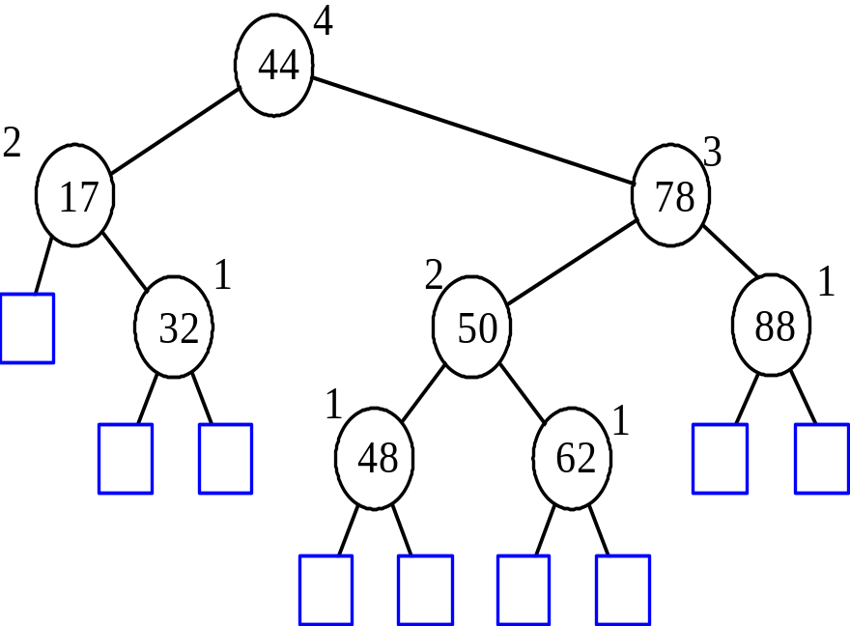
AVL Tree Definition
AVL trees are balanced.
An AVL Tree is a binary search tree such that for every internal node v of T, the heights of the children of v can differ by at most 1.
An example of an AVL tree where the heights are shown next to the nodes:

Slide 3
Height of an AVL Tree
n(2)
3
4
n(1)
Fact: The height of an AVL tree storing n keys is O(log n).
Proof: Let us bound n(h): the minimum number of internal nodes of an AVL tree of height h.
We easily see that n(1) = 1 and n(2) = 2
For n > 2, an AVL tree of height h contains the root node, one AVL subtree of height n-1 and another of height n-2.
That is, n(h) = 1 + n(h-1) + n(h-2)
Knowing n(h-1) > n(h-2), we get n(h) > 2n(h-2). So
  n(h) > 2n(h-2), n(h) > 4n(h-4), n(h) > 8n(n-6), … (by induction),
  n(h) > 2^{i}n(h-2i)
Solving the base case we get: n(h) > 2 ^{h/2-1}
Taking logarithms: h < 2log n(h) +2
Thus the height of an AVL tree is O(log n)

Slide 4
Insertion in an AVL Tree
Insertion is as in a binary search tree
Always done by expanding an external node.
Example:
44
44
17
78
17
78
c=z
a=y
32
50
88
32
50
88
48
62
48
62
b=x
54
w
before insertion
after insertion

Slide 5
Trinode Restructuring
let (a,b,c) be an inorder listing of x, y, z
perform the rotations needed to make b the topmost node of the three
(other two cases are symmetrical)
a=z
a=z
case 2: double rotation
(a right rotation about c, then a left rotation about a)
T₀
T₀
c=y
b=y
T₁
b=x
T₃
c=x
T₂
T₃
b=y
T₁
T₂
b=x
a=z
c=x
a=z
c=y
T₀
T₁
T₂
T₃
T₀
T₁
T₂
T₃
case 1: single rotation
(a left rotation about a)

Slide 6
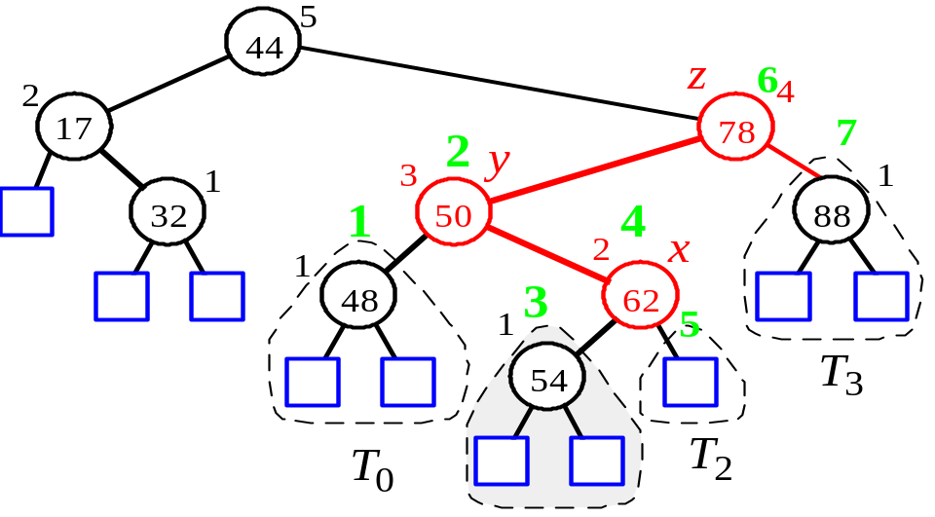
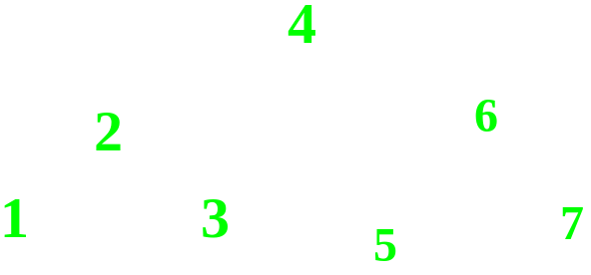
Insertion Example, continued
unbalanced...
T
4
1
44
2
3
x
17
y
62
z
1
2
2
32
50
78
1
1
1
...balanced
48
54
88
T
2
T
0
T
1
T
3

Slide 7
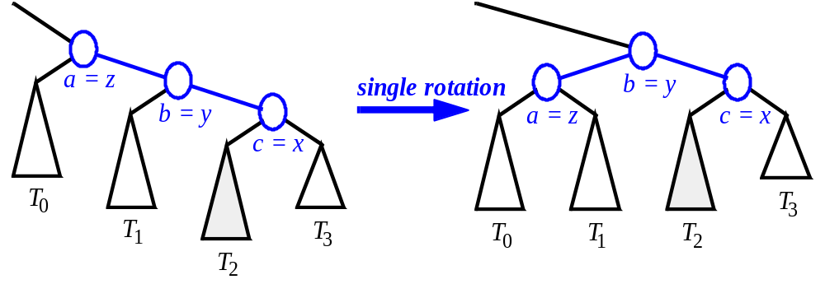
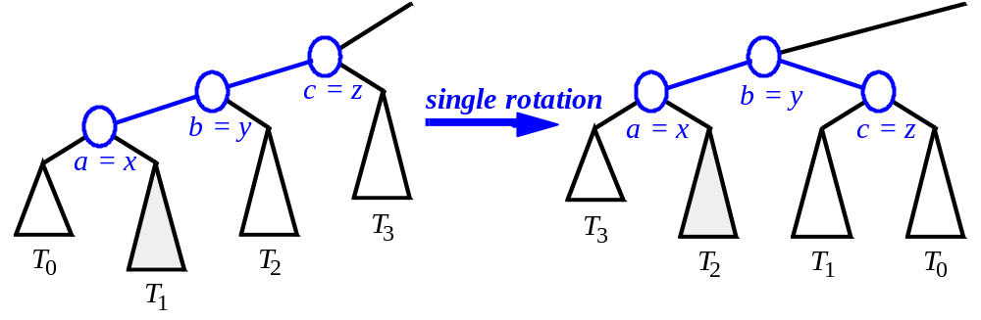
Restructuring (as Single Rotations)
Single Rotations:

Slide 8
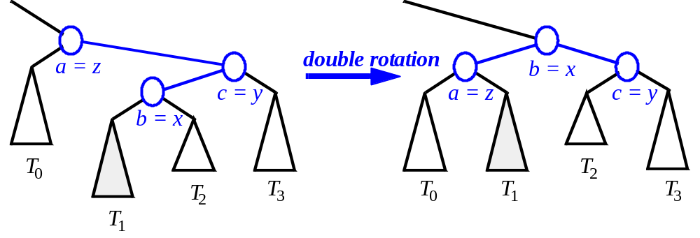
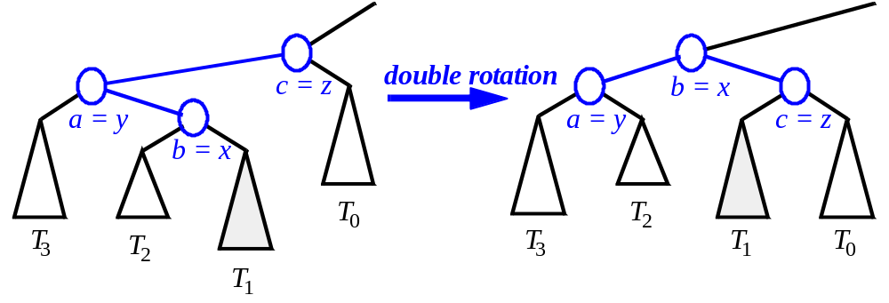
Restructuring (as Double Rotations)
double rotations:

Slide 9
Removal in an AVL Tree
Removal begins as in a binary search tree, which means the node removed will become an empty external node. Its parent, w, may cause an imbalance.
Example:
44
44
17
62
17
62
32
50
78
50
78
48
54
88
48
54
88
before deletion of 32
after deletion

Slide 10
Rebalancing after a Removal
Let z be the first unbalanced node encountered while travelling up the tree from w. Also, let y be the child of z with the larger height, and let x be the child of y with the larger height.
We perform restructure(x) to restore balance at z.
As this restructuring may upset the balance of another node higher in the tree, we must continue checking for balance until the root of T is reached
62
a=z
44
44
78
w
17
62
b=y
17
50
88
50
78
c=x
48
54
48
54
88

Slide 11

Running Times for AVL Trees
a single restructure is O(1)
  using a linked-structure binary tree
find is O(log n)
  height of tree is O(log n), no restructures needed
insert is O(log n)
  initial find is O(log n)
  Restructuring up the tree, maintaining heights is O(log n)
remove is O(log n)
  initial find is O(log n)
  Restructuring up the tree, maintaining heights is O(log n)

